Slide 1
words clouds 1114
File created on: 2019-11-14 오후 8:58:51

Slide 2
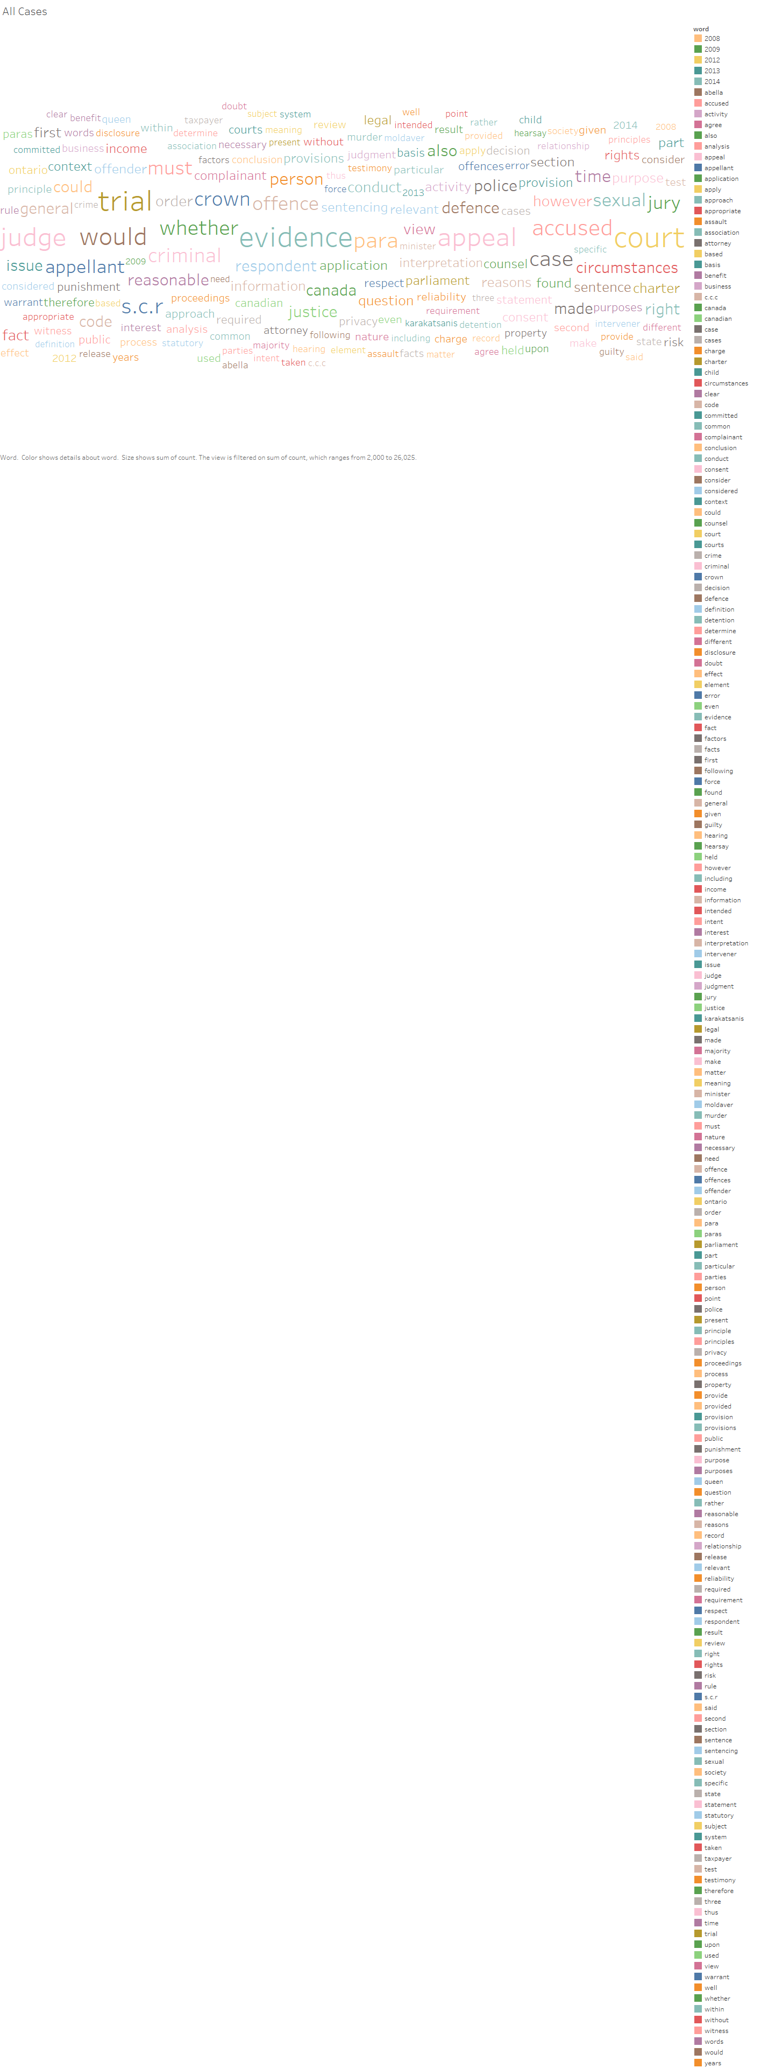

Slide 3
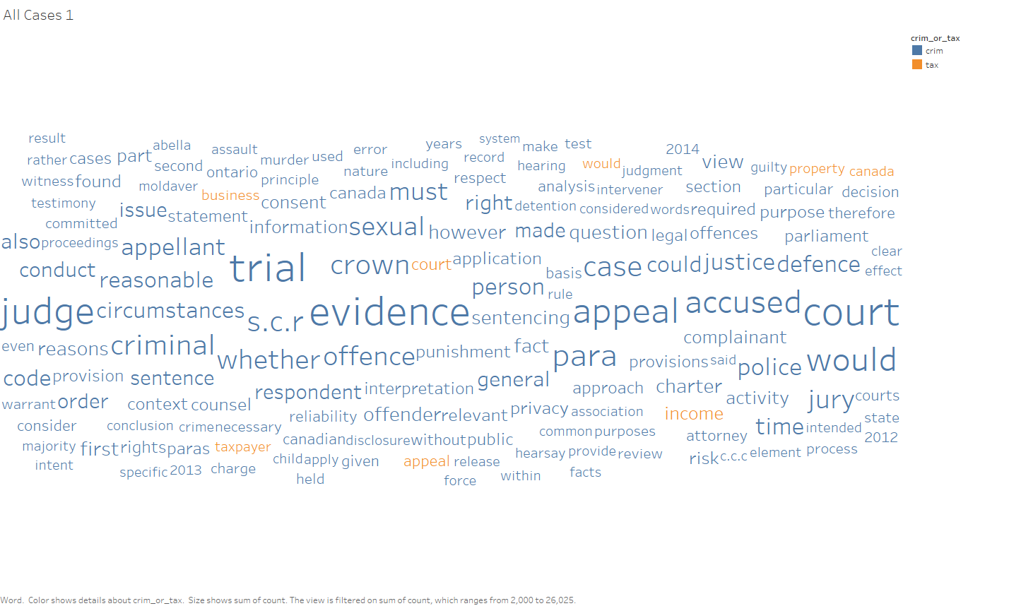

Slide 4
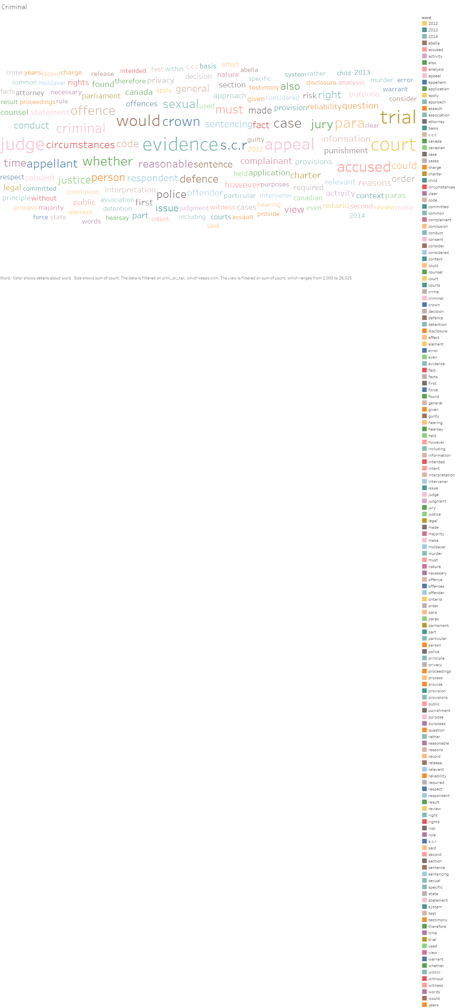

Slide 5
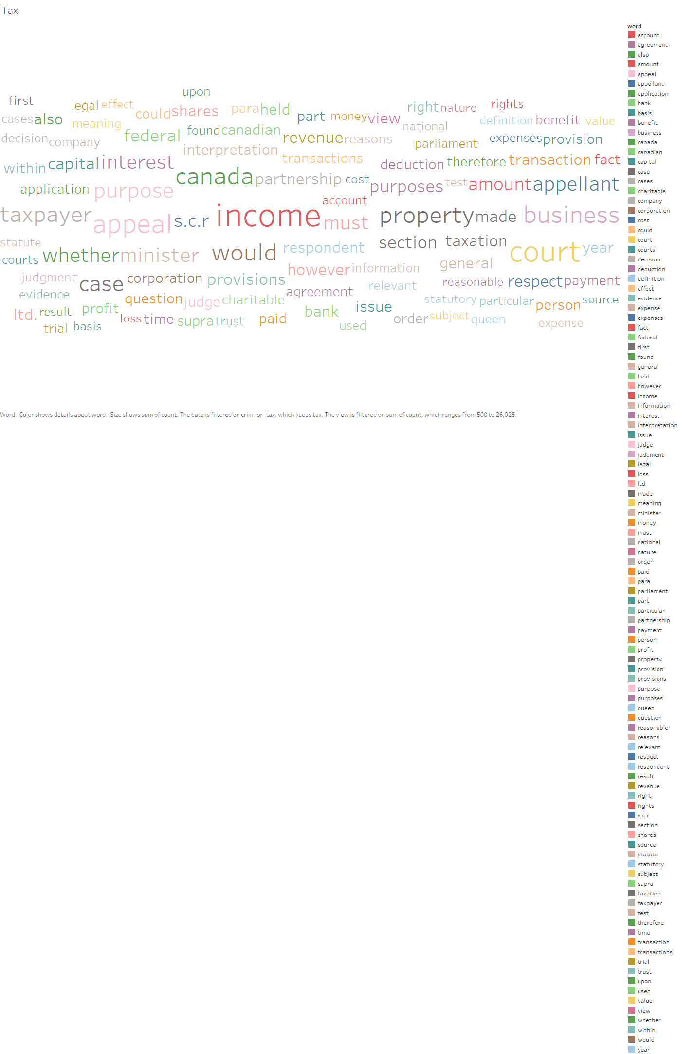

Slide 6
